Slide 1
Term Project
DC Motor Speed Control with Compensator
Class : | Physical System Modeling and Control
Instructor : | Prof. Park, Kyi Hwan
members : | 20151049 최윤정 20151160 Abdullah Tahir,

Slide 2
Contents
1
Overview
2
Motor Transfer Function
3
Circuit
PID Controller
Designing
4
Circuit
Lead-lag Compensator
Designing
5
Q & A

Slide 3
1. Overview
Goal is to enhance the plant performance
Motor
PID Controller
Bode Plot
Lead-Lag
Compensator
Root-locus
GM & PM
Zeigler
-Nichols
PID & Lead-Lag compensator
PID Controller.
→ We can not directly specify Tr, Tp, %O.V and Ess.
Lead-lag compensator
→ We can directly specify Tr, Tp, %O.V and Ess.

Slide 4
1. Overview
Block diagram
Block diagram of Whole system
V ref
+
Controller
Voltage
Amp
Plant
(Motor)
Velocity
-
Tachometer

Slide 5
2
Motor Transfer Function

Slide 6
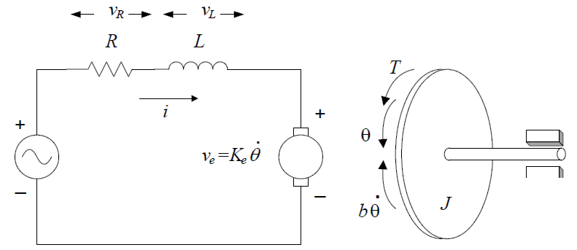







2. Motor Transfer Function
Mathematical Modeling of Armature Control DC Motor
Motor Torque
Kirchhoff’s law
Notes:
Result of calculation

Slide 7

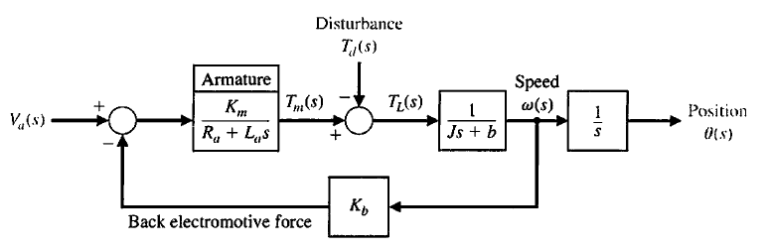

2. Motor Transfer Function
Transfer function
Finally,
: Position control Transfer function
Velocity control Transfer function

Slide 8
3
PID Controller

Slide 9
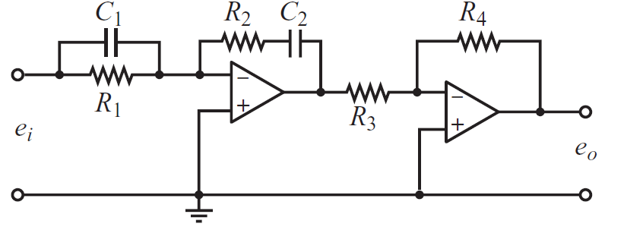

3.PID Controller
Gain Margin and Phase Margin
We can increase Gain Margin and Phase Margin
We can do Loop Shaping
We can adjust Transient Response (Tr, Tp, OS)

Slide 10
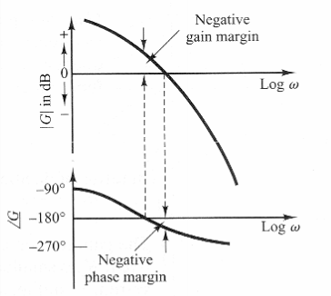
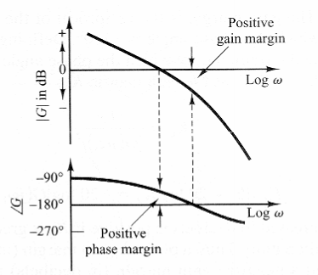
3.PID Controller
Gain Margin and Phase Margin
1. Gain Margin(GM) & Phase margin(PM)
PID
Unstable system
Stable system

Slide 11
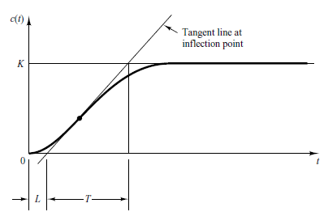

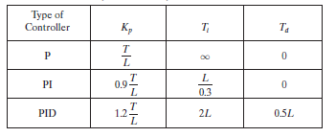
3.PID Controller
Zeigler-Nichols Method
Method 1 Ziegler-Nichols Tuning Rule Based on Step response of Plant.

Slide 12
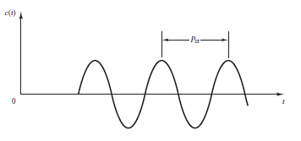
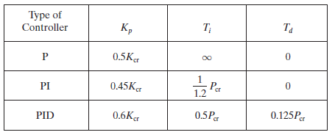
3.PID Controller
Zeigler-Nichols Method
Method 2 Ziegler-Nichols Tuning Rule Based on Critical Gain and Critical Period.

Slide 13
4
Lead-lag compensator

Slide 14
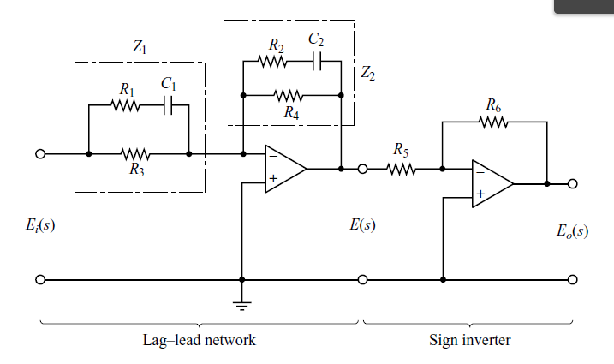


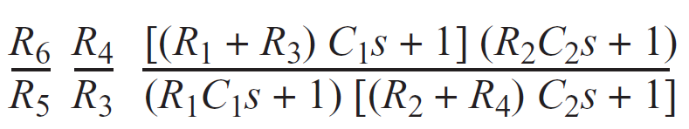
4.Lead-lag Compensator
Circuit
OR
Lead part Lag part

Slide 15




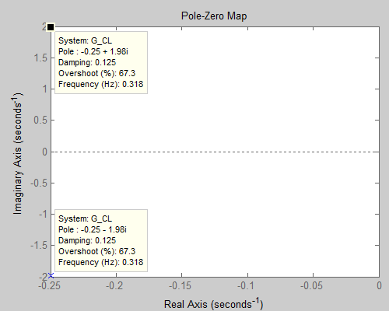
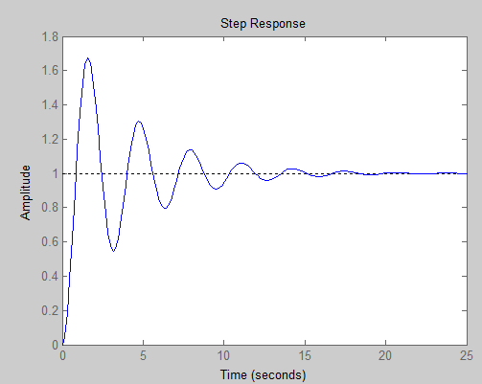
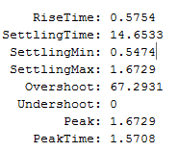
4. Lead-lag compensator
Designing
We can consider G(s) as motor transfer function considering La = 0.
Original spec.
Desired spec.
Closed loop poles
Damping ratio
Natural frequency
Static velocity error constant
Notes:
→

Slide 16

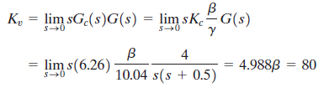


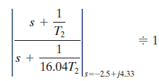
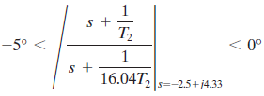


4. Lead-lag compensator
Designing
- Lead-lag compensator
Closed loop poles
=180(2k+1)
Now we have to select zeroes and poles of lead part for angle condition of 55*.
Let graphical analysis: 1/T1 = 0.5 and γ/T2 = 5.02
Notes:
→

Slide 17
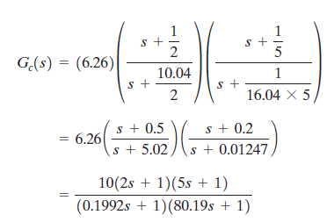

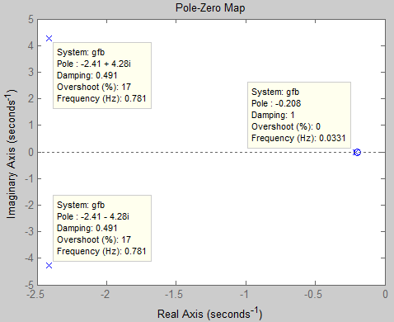
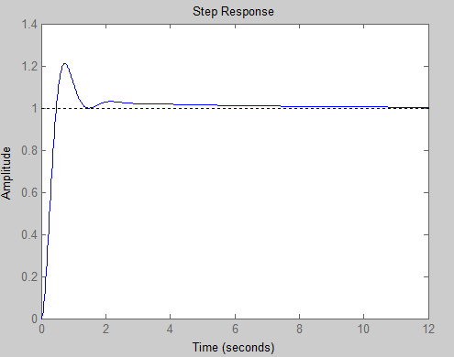
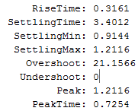
4. Lead-lag compensator
Designing
Notes:
→

Slide 18
Thank You

